Slide 1
Nano – week 12
2/11 – 27/11
Klara, Yoran, Oscar

Slide 2
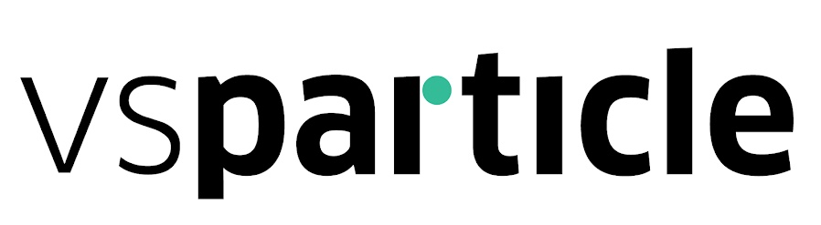
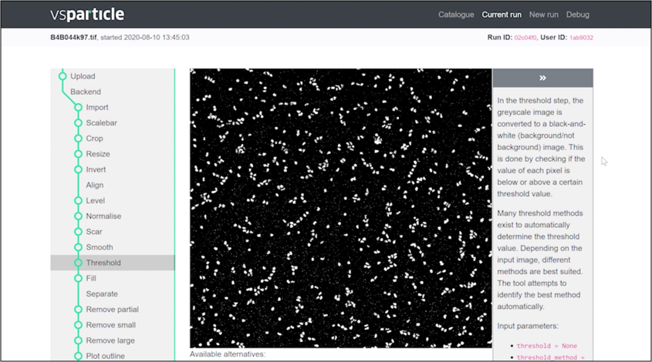
objective
Project recap
Nano particle images
Image processing tool
Predict best Threshold method

Slide 3
What have we done
Last 4 weeks
Imbalanced data methods
Look at more models
Data revisit
Experiment for all combinations

Slide 4
Imbalanced data methods
Last 4 weeks
Cluster-based Oversampling
Random Oversampling
SMOTE
Not enough data for under sampling

Slide 5
Models
Last 4 weeks
Decision Tree
Logistic Regression
MLP Classifier
Random Forest Classifier

Slide 6
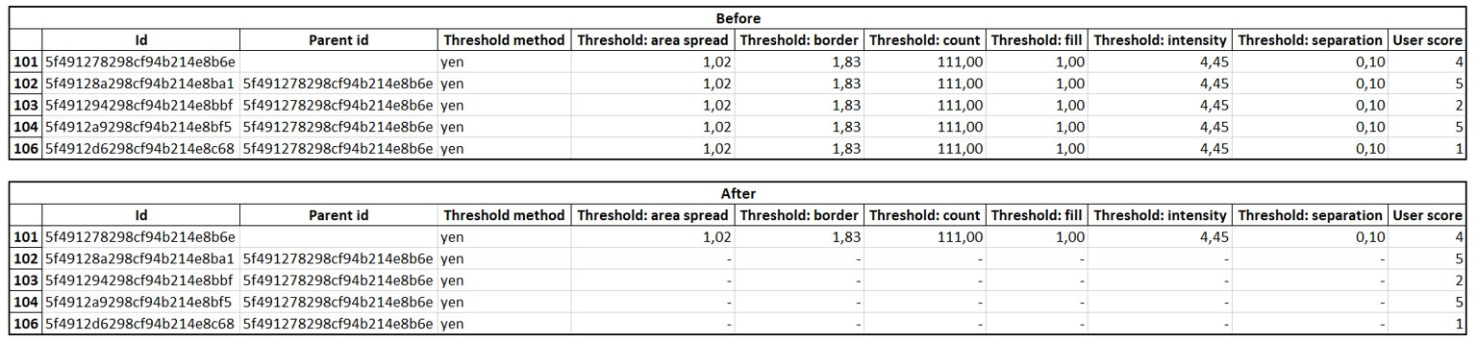
Data revisit
Last 4 weeks
Bug in the code
Duplicate data with different user scores
Verifying with product owner
Removed wrong data
22 less samples

Slide 7
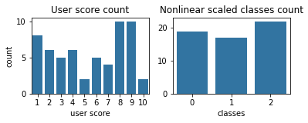
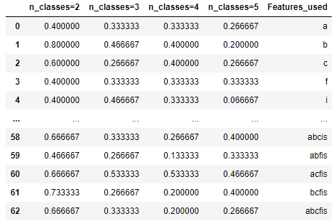
THE EXPERIMENT
Last 4 weeks
Split user-scores into classes
More samples
Nonlinear classes
Split features in all possible combination
Not many features (6)
Create Data Frame for each combination
model -> Balancing method -> classes -> Feature combination
Decision Tree with Cluster-based Oversampling SMOTE

Slide 8
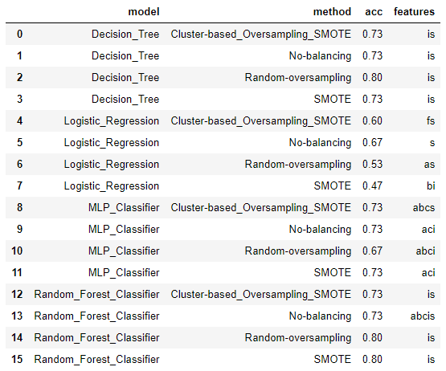
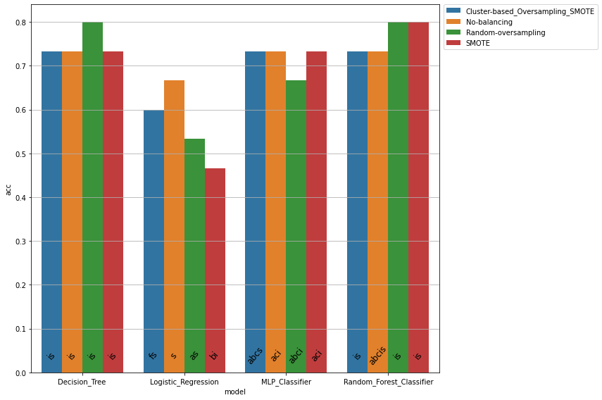
RESULTS for 3 classes
Last 4 weeks - THE EXPERIMENT

Slide 9
Coming weeks
Next steps
Improve the experiment with optimization to models
Create more insight into results
Pick combination we want to recommend using
Optimize the combination

Slide 10
Any questions or feedback?
Thank you!

